Slide 1
Advanced Intelligence Surveillance POC Executive Outcome Summary
RDP LT
March 2022

Slide 2
Agenda
Awareness
The concept is feasible using internal capability and value has been realised and early adopters interested in real world pilot and have identified more demand
Lessons Learned
Our thoughts / consideration
Sponsors Feedback & Agree Next Steps
Note: POC was delivered on time and under budget

Slide 3
Big Thank you!
Thank you to all the individuals who helped make the project a success!
Sponsors & Business Units – RDP LT, AIA LT, GRIP and Quality Assurance for taking the risk!
RDP RMs, PP CoE and ALM
IDEA (Architecture & Environment)
AIA (Knowledge Management, Architecture & Environment)
DT Organization (EA, Aha & Sinequa)
IS Compliance (R&C)
Vendors & Partners – Sinequa, TCS, Cognizant, & Many Others

Slide 4
Regulatory affairs value statement
POC Use Case and Learning
Enable target keyword search of limited number of regulatory agency and other websites around Medical Device topic area
Key learning from POC incorporated into core capability and use case requirements
Future Demand Identification
Priority 1: Target keyword search of websites for regulatory agency approval of Astellas products
Priority 2: Target keyword search of all (>100) websites article relating to Medical Device Intelligence (replace ABIS) and Regulatory Trends
Priority 3: Target keywords search of documents – PDFs, Words, Excel, PowerPoint etc in websites
Take Away Message:
Test solution feasibility and compare solution options
Intelligence Surveillance on demand across geographies
React faster to changes
Reduced price point for data science capability
Competitive advantage
New Technology & Developments
New ways of working with IS – IS initiated Innovation
Tangible Benefits Identification
Tangible benefit worth 340 k USD per annum – net benefits subject to spend to replace capability

Slide 5
quality assurance value statement
POC Use Case and Learning
Enable target keyword search of limited number of regulatory agency website for Quality Intelligence & Inspection Readiness Trends for GCP
Key learning from POC incorporated into core capability and use case
Future Demand Identification
Priority 1: Target keyword search of all (>100) websites article relating to Quality Intelligence & Inspection Readiness Trends for for GCP, GMP, GVP, GLP, Supplier Quality for Drug, Medical Devices, and Combination Products topic areas
Take Away Message:
Test solution feasibility and compare solution options
Intelligence Surveillance on demand across geographies
React Faster to changes
Reduced price point for data science capability
Competitive advantage
New Technology & Developments
New ways of working with IS – IS initiated Innovation
Tangible Benefits Identification
Tangible benefit worth 100 k USD per annum – net benefits subject to spend to replace capability

Slide 6
Platform value
Prototype solution and Feasibility Testing
Infrastructure
Definition of Solution Architecture for POC and review of solution by AIA and RDP IDEA
Prototype solution on interim server - may impact on other service – IDEA
Open Data Intelligence
Manual keyword search list
Keyword scraping of articles from simple and complex websites
Transformation of data to enable summary
Basis summary using NLP
Storage of data to enable intelligence gathering and trending
Dashboard with basic search article trending using Visualization tool
Subscription Data Intelligence (Bonus)
Keyword scraping of articles from simple and complex websites
Manual export of raw data from keyword search into solution
Take Away Message:
Test solution feasibility and compare solution options
Better branding
Understand our Customer better
Collaboration between DT, IS, AIA, RD PPP CoE and other competency
New Technology & Developments
New ways of working with our customers

Slide 7
Lessons Learnt
7
No | Opportunity | Remediation Options
1 | Innovation Framework | Enterprise Innovation Framework Technical Environment Level of ceremony (R&C) Astellas Enterprise Standard
2 | Innovation Culture | Agile ways of working Showcase / awareness sessions
3 | Demand management | Single point of business accountability to champion evolution Enterprise governance (demand prioritization - business demand and other competency centers)
4 | Strategic Alignment | Executive sponsorship to champion Intersection between CSP and capability

Slide 8
Enterprise innovation framework (Example)
Go / no-go
Go / no-go
POC / Protoype
Pilot in real world
Develop & deploy
Maintain & enhance
Internal capability
Product owners to engage business and ‘own’ methodology
Product owners with largely outsourced development
Product owner with technical / IS support
External support
Specialist / high-end data science and/or data engineering from academia and business
Programme management
Specialist high-end data science and/or data engineering
External software development and programme managers
Change management support
Flexible support for new development and ad hoc enhancements
Input from external partners
Specialist / high-end expertise and best practice
Resource flexibility (scale up and down easily versus fixed internal headcount)

Slide 9





Intelligence and Insights Surveillance (Example)
Using existing Astellas cloud services tenant
MA Insight
MicroService
MicroService
MicroService
MicroService
MicroService
1. Web-scraping
2. Processing
3. Transformation
4. Storage
5. Proactive Strategy
Advanced Intelligence –
RA and QA
The system collects articles and data from selected websites.
The article text is searched for key words and summarised using Natural Language Processing.
The text collected from the articles is then transformed into a structured format (a table).
The processed and transformed data is then stored in a database and filtered for different user groups.
The filtered data is then shared in checklist, emails, alerts, actionable workflows, dashboards etc.
Other POCs, Project
New + Existing (Sinequa)
New
New
Infrastructure (AWS) –
James Walsh
New

Slide 10
Possible AIS approach
Proof of Value
Foundation Components
Pilot in real world
Maintain & Enhance
Prototype Solution
Governance & Demand Management
(Baseline )
Delivery Increments
Proof of Value
New Environment, Migration & SLC
Storage & Architecture Patterns (Baseline)
Future Demand
NLP
(Baseline)
Front End & Analytical Tools
(Baseline)
Business Process
(Baseline)
End to end use cases delivered at speed via iterative development
Development Team
Priority Use Cases
Foundational components necessary to enable end to end use cases delivery (MvP)
Regulatory Use Cases
Quality Use Case
Other Use Cases
Business As Usual Service
(Baseline)
Delivery Increments

Slide 11
Take away message
Awareness
The concept is feasible using internal capability and value has been realised and early adopters interested in real world pilot and have identified more demand
Lessons Learned
Our thoughts / consideration
Agree Next Steps

Slide 12
Appendix

Slide 13
Phase Closeout Activities
13
Investment proposal & Financing for potential Next Phase
Deliverables & Supporting documentation location
Socialization with wider Astellas

Slide 14



Prototype Lifecycle & Deliverable
An data science capability providing web scraping, storage, data transformation, categorisation and delivery of data through an agreed medium
Acquisition and Integration
Transformation
Enrichment & Storage
Distribution
0
1
0
1
0
1
0
0
1
1
Lifecycle
Diverse information is acquired and integrated in real-time from a large catalogue of content sources and connectors
The information is then transformed into a normalized format
It is enriched using proprietary natural language processing (NLP)
The final stage of the Smarter Data Process focuses on delivering this information in a way which suits your organization best.
Websites selected for the proof of concept
Sets of keywords are used during the scraping process to identify articles of relevance
The Clusters identified as being the most useful categorisations e.g. Article lists, Mixed text/documents, Research lists
A Natural Language Processing algorithm applied to the scraped article to produce:
A short summary of the article's introduction
A short summary of the content within the article where the keywords were identified
The processed and transformed data stored in a database and filtered for different user groups (Intelligence Database).
Visualization of data
Deliverables
Keywords summary, Long summary, URL Links

Slide 15
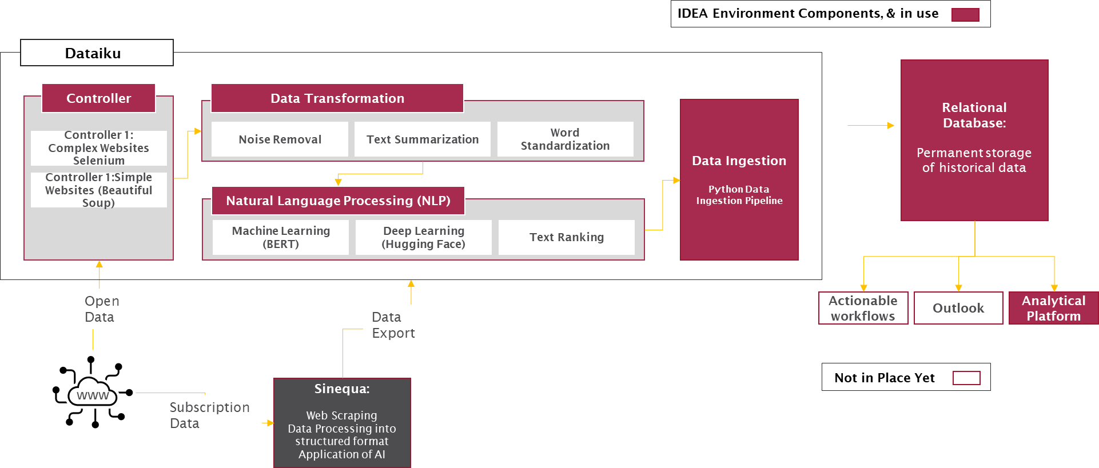
POC architecture
Take Away Message:
Leveraged the best practice and approaches (AIA, DT, IDEA etc)
Astellas Data Science platform standards – Dataiku
Tableau for Visualization to speed up and plan to move to Astellas standard QlikSense in future
Compared capabilities of Sinequa platform
Actionable Workflows and Outlook exploration in next phase
Email functionality that would have summary of article – administrator account for Pinksheets – category and key sheets
The POC architecture demonstrates full functionality while reducing costs through the use of resources with the minimum viable performance and the removal of non-functional features such as resilience

Slide 16
Agile Ways of working success
16
Project Phases
DEC-21
JAN-22
FEB 22
MAR 22
Take Away Message:
We hit our delivery commitments
On Time
Under Budget
Did more than Scope
We adopted agile way of working where we defined deliverable ahead of each sprint then reviewed with the business at the end of each sprint
Delivery challenges were to do with agreements on environment to use and delay onboarding or getting commitments for competency center
With agreement from R&D, No SLC for POC which reduced documentation burden
Kickoff
Team onboarding. Infra setup
Planning
User story refinement and prioritization.
Sprint Delivery
Sprint 1
Sprint 2
Sprint 3
Sprint 4
Closure
POC Outcome

Slide 17
Organizational structure success
17
Product Owner
Michael Ogbeide
Business Sponsor
Fred Ivanow / Gary Novak
AIA
Abby
Take Away Message:
Strong sponsorship from RDP and AIA leadership
Strong stakeholder interest and engagement from GRIP and Quality Leadership and business teams
Strong support and engagement from Aha/Sinequa, IDEA and AIA on environment
Showcase to Medical Library Services, HEOR (MA), CCP, PV, Competitive Intelligence, etc
Leveraged the same agile team to work with Global Regulatory Intelligence & Policy (GRIP) and Quality Intelligence Group
Ashish Roy (PM)
RDP RMs
Support Functions
Agile Teams
Technical Team
GRIP Business Team
Quality Business Team
Infrastructure
Sinequa Team
Database SME
Naveeta
Valeria Aleksandrova
Harry Watson
IDEA SME
Brian Nigl
Caio Frietas Pumal
NLP Technical SME
Nikil
Korina Anagnostou
AIA SME
Muhammad Siddiqui
Front End
Naveeta
IDEA SME
Paul Batulis

